Slide 1
Labview & live data acquisition
Dominic Martinez-Ta
Physics 177-Computational physics

Slide 2
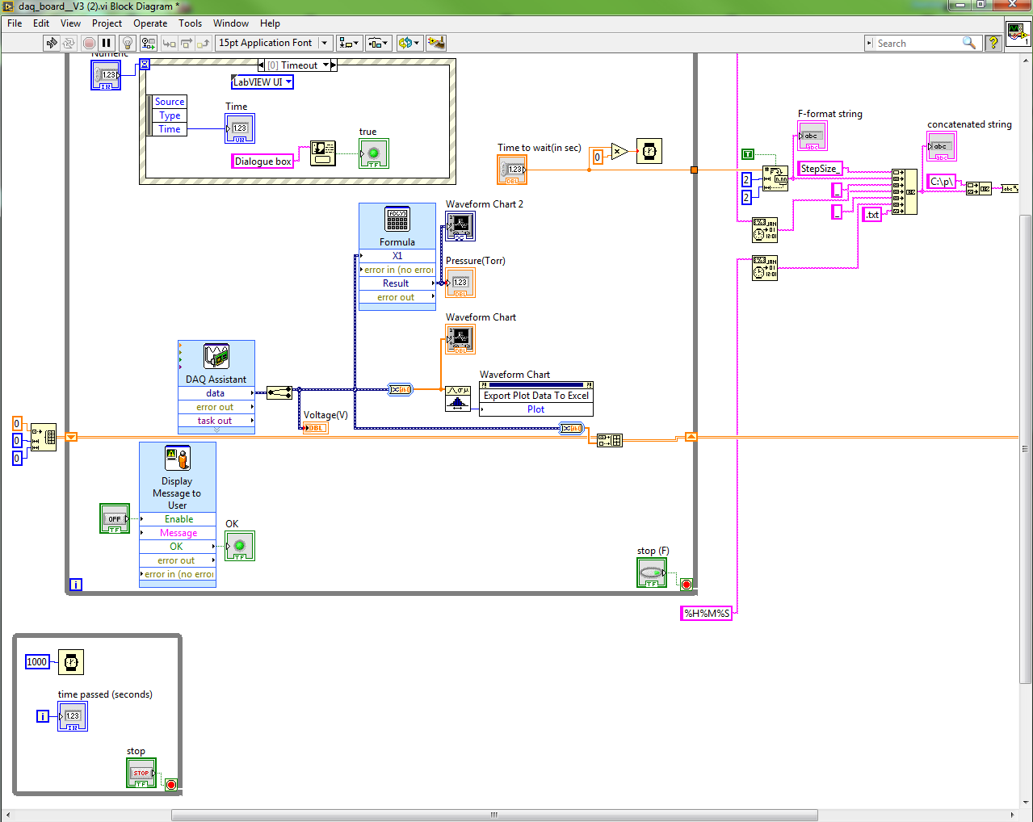
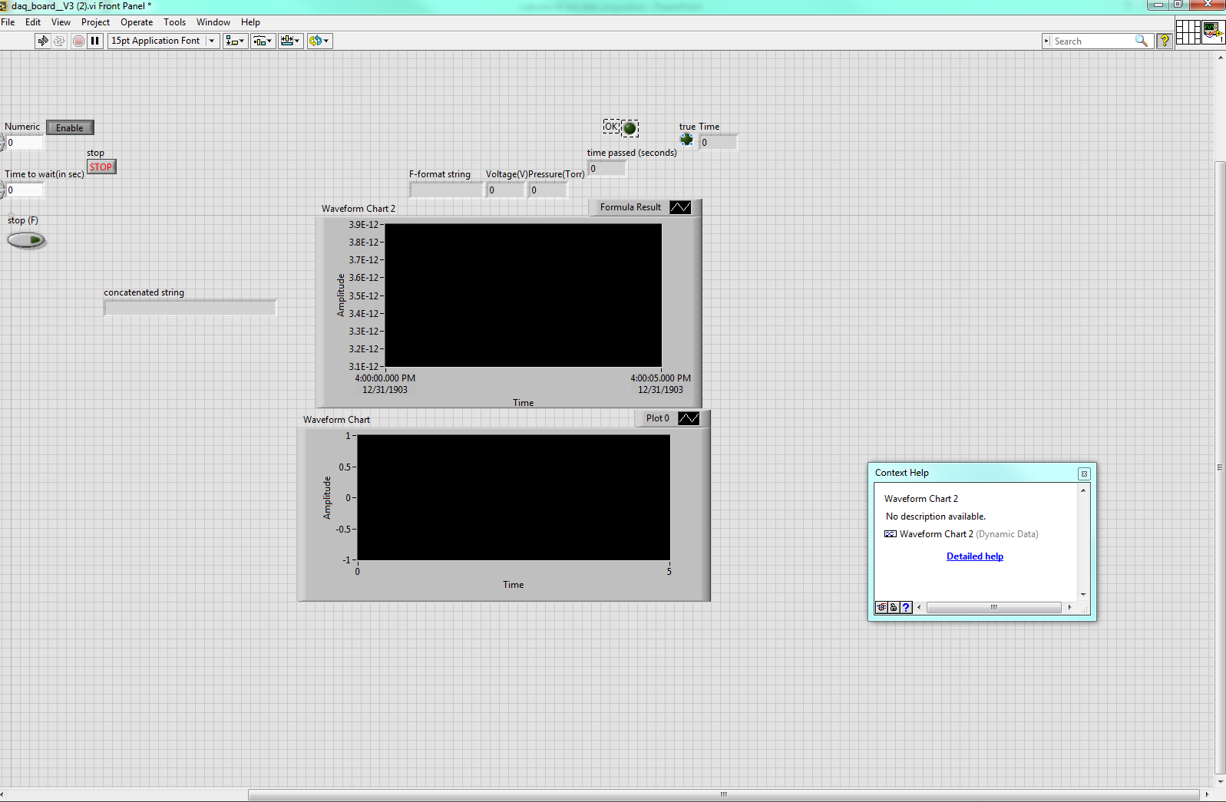
Block Diagram

Slide 3
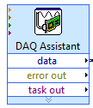

Above- Daq Assistant is basically a program allowing us to acquire data and output it to either numbers or onto graphs.
Below- This is a while loop. Anything inside of it is within it’s boundaries.

Slide 4
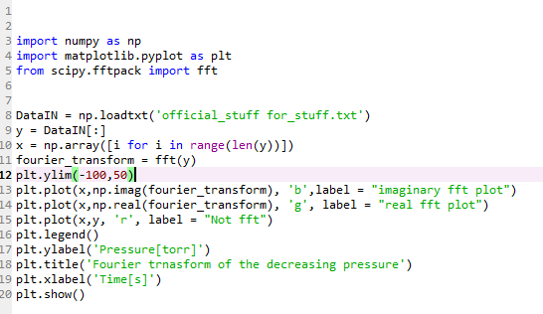
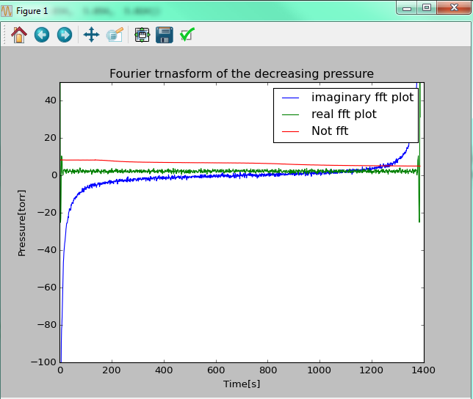
Fft of the decreasing pressure

Slide 5
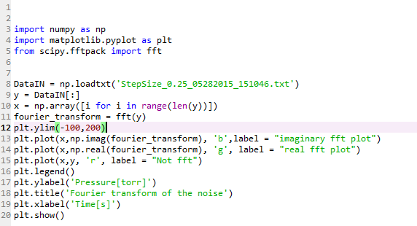
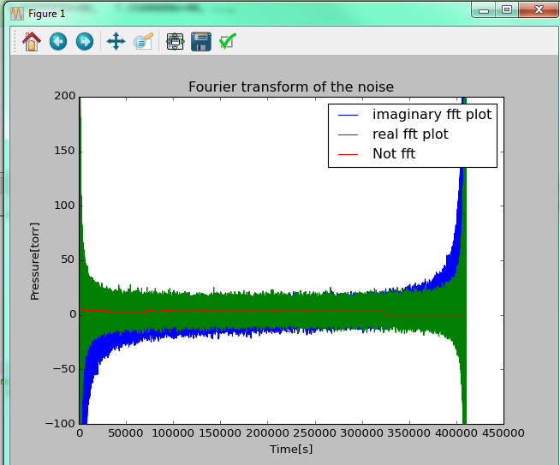
Noise graph

